Slide 1
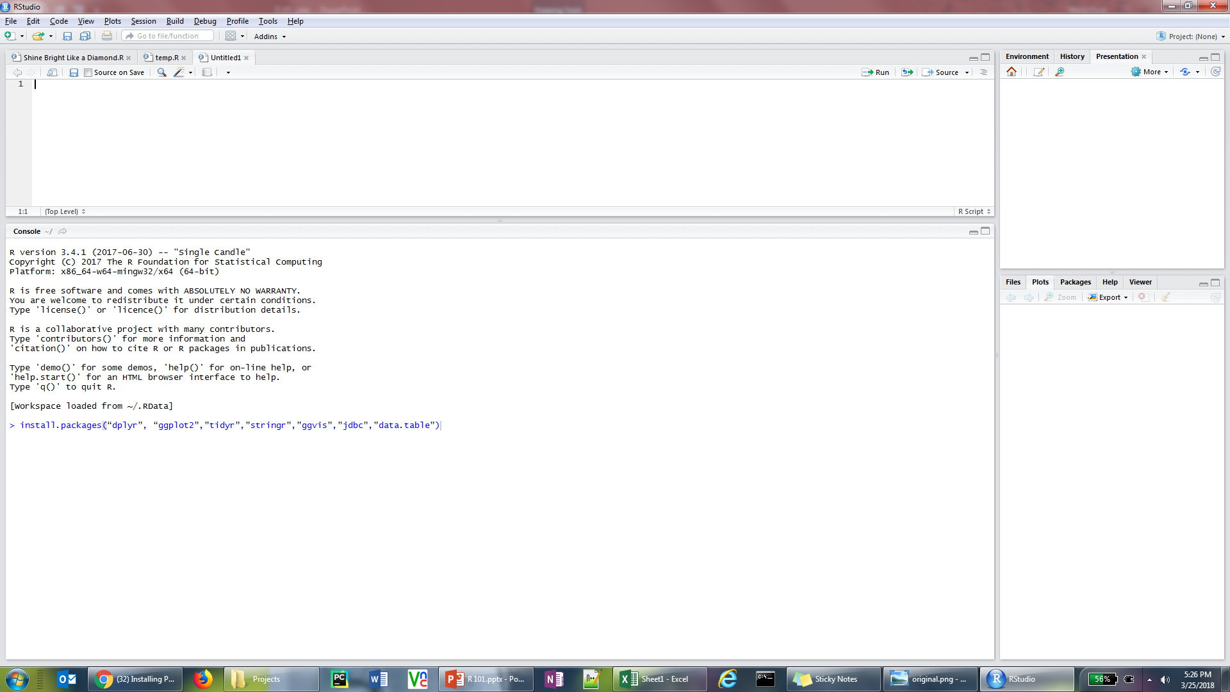
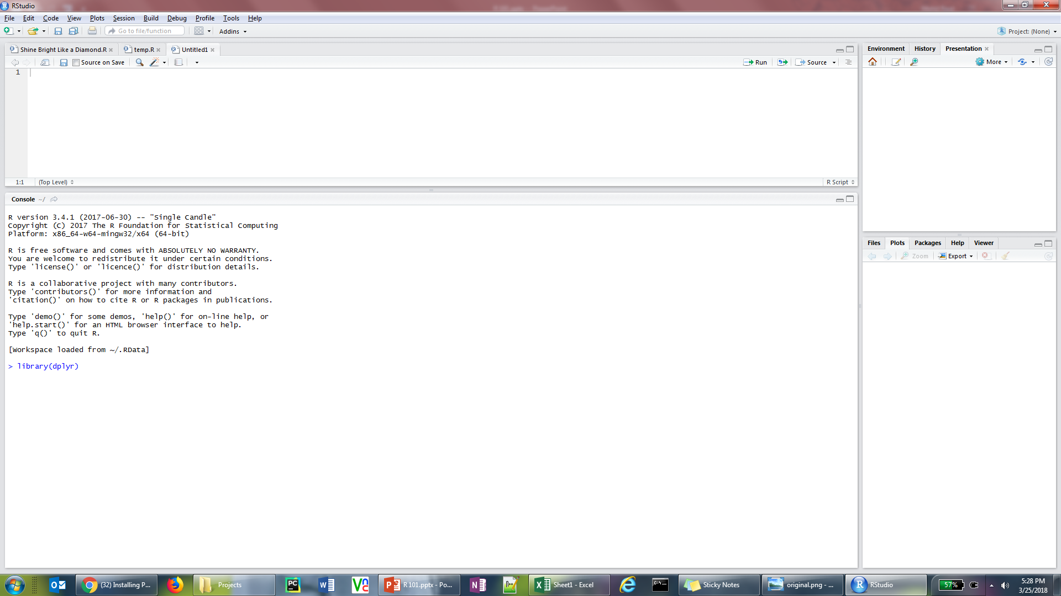
R INTSALLATION
Installing R
Download and install the latest version of R from the following link: Download R
Download and install the latest version of Rstudio from the following link: Download RStudio
Contact IT to get access for all of the installation steps required to install R, RStudio and packages in R
In the console window run the following command to install all required packages needed for the training sessions
install.packages(“dplyr”, “ggplot2”, “ tidyr”, “ stringr”, “ data.table”)
Load the packages by calling the library command in the Rconsole
library(dplyr) (Run this command for all the above packages while you have access from IT else the packages won’t be accessible)
Visit the following link for any assistance required for package installation: Installing Packages in R

